Slide 1
Kijan pou w koute tradiksyon lang lan:
Cómo escuchar la interpretación de idiomas:
Como ouvir a interpretação de idiomas:
Windows | macOS | Kliyan sou Entènèt
Windows | macOS | Cliente web
Windows | macOS | Cliente da web
Nan kontwòl reyinyon ou/oswa webinar ou, klike sou Entèpretasyon.
Klike sou lang ou ta renmen tande a.
(Opsyonèl) Pou w tande sèlman lang entèprete a, klike sou Ansil Original Audio.
En los controles de tu reunión o seminario web, haz clic en Interpretación.
Haz clic en el idioma que deseas escuchar.
(Opcional) Para escuchar solo el idioma interpretado, haz clic en Silenciar audio original.
Nos controles da sua reunião/webinário, clique em Interpretação.
Clique no idioma que você gostaria de ouvir.
(Opcional) Para ouvir apenas o idioma interpretado, clique em Silenciar áudio original.
Android | iOS
Android | iOS
Android | iOS
Nan kontwòl reyinyon ou, tape sou bouton plis (twa ti pwan).
Tape sou Entèpretasyon Lang.
Chwazi lang ou vle tande a.
(Opsyonèl) Tape sou bouton pou mete son orijinal la sou silans.
Tape Fini.
En los controles de la reunión, toca el botón de más opciones (tres puntos).
Toca Interpretación de idiomas.
Selecciona el idioma que deseas escuchar.
(Opcional) Activa la opción para silenciar el audio original.
Toca Listo.
Nos controles da reunião, toque no botão de mais opções (três pontos).
Toque em Interpretação de idioma.
Escolha o idioma que deseja ouvir.
(Opcional) Toque na chave para silenciar o áudio original.
Toque em Concluído.
Windows | macOS | Web Browser
Android | iOS
In the controls of your meeting or webinar, click on Interpretation.
Click on the language you want to listen to.
(Optional) To hear only the interpreted language, click on Mute original audio.
In the meeting, tap the More options button (three dots). controls
Tap Language Interpretation.
Select the language you want to listen to.
(Optional) Turn on the option to mute original audio.
Tap Done.
How to Listen to the Presentation in English:

Slide 2
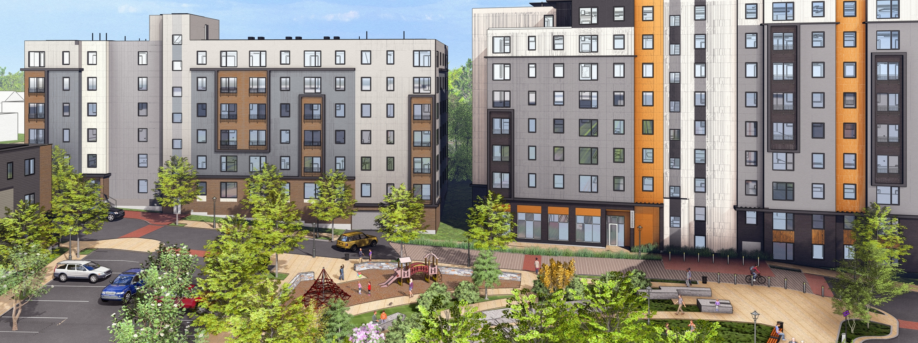
CLARENDON RESIDENT MEETING January 26, 2026 rescheduled to February 2, 2026

Slide 3
Introductions
Interpretation Needs (Virtual)
POAH & POAH Communities
Clarendon Residents United + Legal
Somerville Community Corporation
City of Somerville – Somerville Office of Immigrant Affairs

Slide 4
Meeting Agenda
Introductions
Resident Announcements
Phase 2 Updates
Know Your Rights Training
Office Hours & Upcoming Events
Q&A

Slide 5
Resident Announcements:
617-616-2424
Press 1
for
Office
Press 2
for
Clarendon Residents United
Please pick up after your animals.
Maintenance Work Orders
Enter online through Rent Café
Email or call the office
New Community Impact Coordinator hired, starts in February 16th. Kenlyne Exume
Monthly CRU meeting
Elections – we will discuss more at our next meeting on February 23, 2026
20stephenson@poahcommunities.com

Slide 6
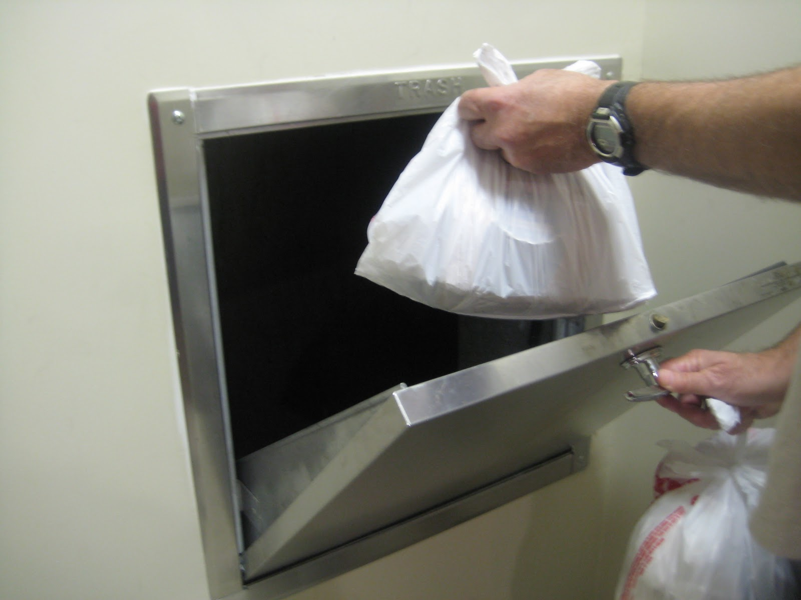

Trash Room Guidance:
Recommend using 13-gallon kitchen bags or smaller, not big black contractor bags
Cardboard must be broken down.
Leave Recycling in the big black bins or make sure to push the green button
If you have larger items, please call the office to coordinate disposal.

Slide 7
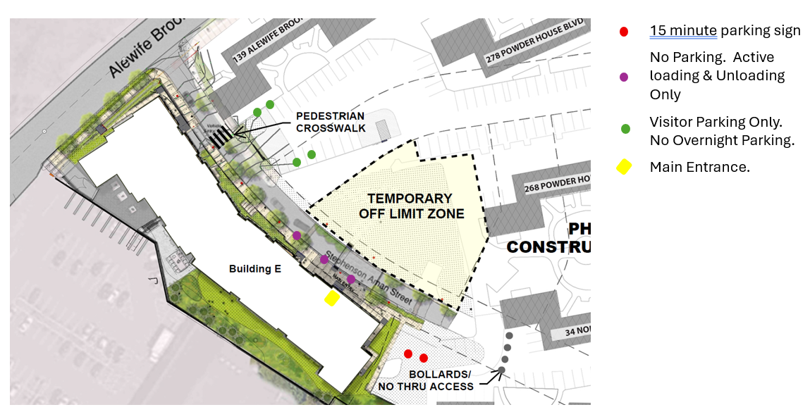

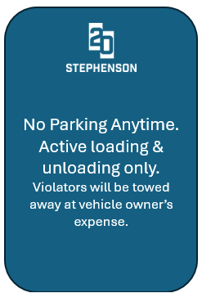
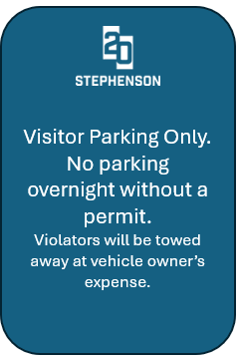
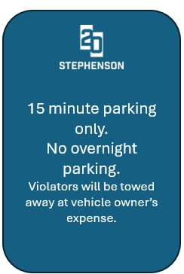
Parking Information:
TEMPORARY
PARKING LOT
FENCED OFF
ZONE

Slide 8
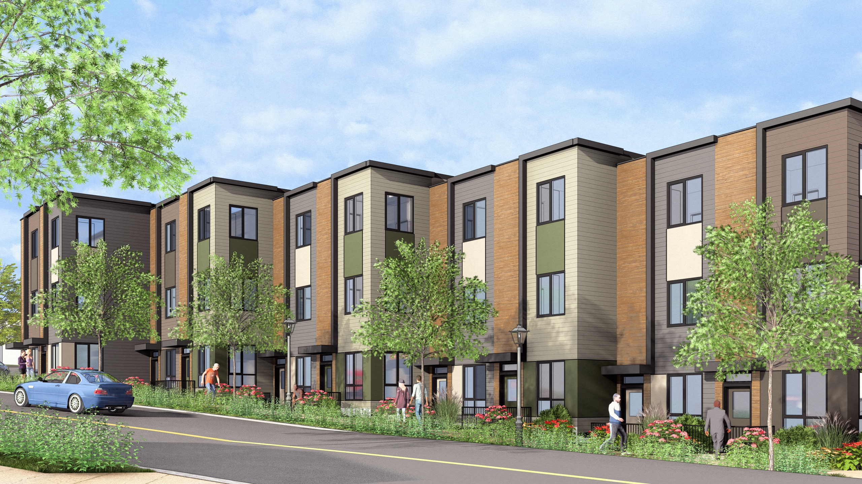


Phase 2 Updates
Phase 2 funding has been received!
Construction will begin in mid-2026 after Building E is complete and fully leased & new financing is in place
Construction anticipated to be completed in 2028, with building fully leased up in 2029
Phase 2 includes Building D (58 units) and Townhomes (34 units), along with a Head Start classroom and playground, community garden, and park space
Note: This is likely the final growing season for the current Clarendon Hill garden. The development team is working with SHA to identify a possible interim garden option during Phase 2 construction.

Slide 9
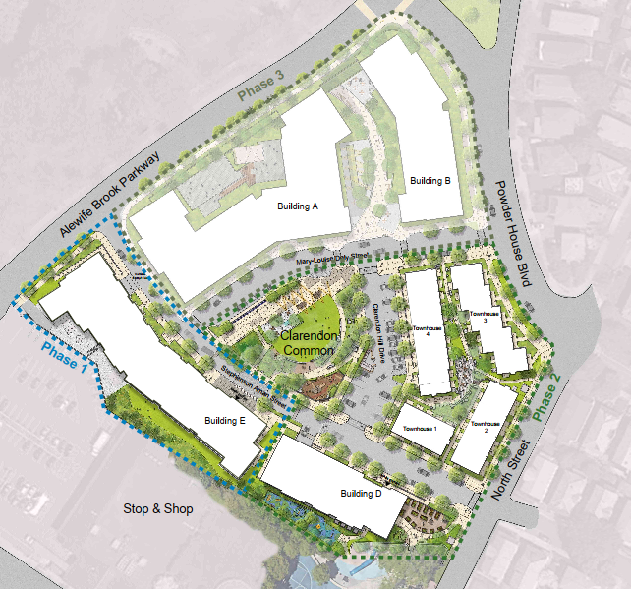
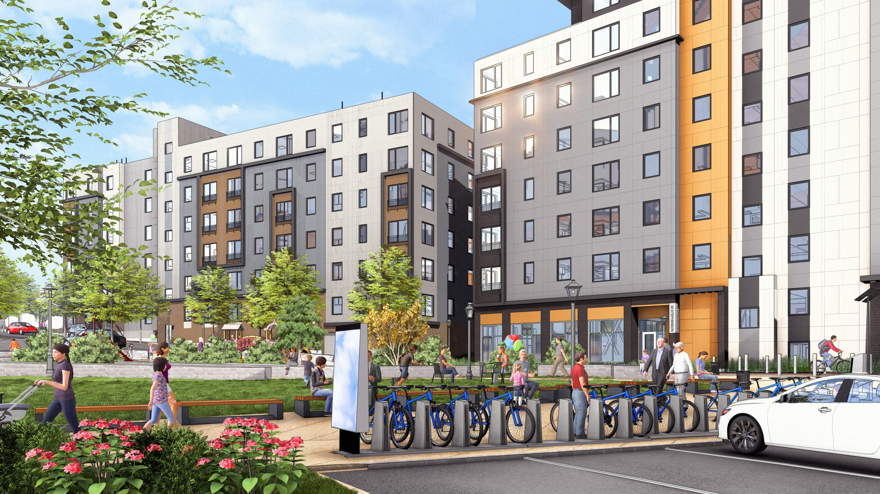
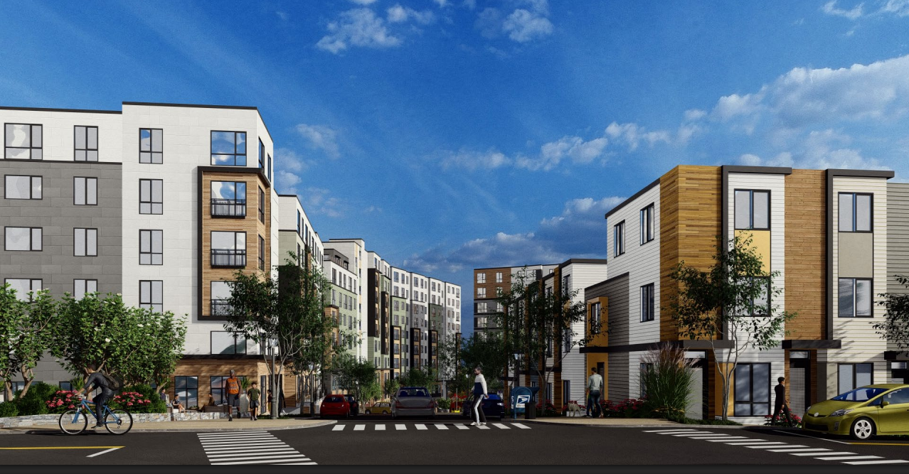
Phase II Site Plan
Phase II Site Plan:

Slide 10
Do you have questions? Please contact:
Clarendon Residents Union (CRU): ClarendonResidentsUnion@gmail.com
Developers:
Jamie Carroll: jcarroll@poah.org
Beatriz Gomez-Mouakad: bgomez@somervillecdc.org
Relocation Specialist:
Kamika Marsh: kmarsh@housingopportunities.com; 617-344-9616
Management Team (POAH Communities):
Tomson Wang: jwang@poahcommunities.com; 617-939-1977
Community Building, Engagement, and Organizing (SCC):
Raul Salinas Ortega: rsalinasortega@somervillecdc.org

Slide 11
SOIA – Know Your Rights

