Slide 1
Kijan pou w koute tradiksyon lang lan:
Cómo escuchar la interpretación de idiomas:
Como ouvir a interpretação de idiomas:
Windows | macOS | Kliyan sou Entènèt
Windows | macOS | Cliente web
Windows | macOS | Cliente da web
Nan kontwòl reyinyon ou/oswa webinar ou, klike sou Entèpretasyon.
Klike sou lang ou ta renmen tande a.
(Opsyonèl) Pou w tande sèlman lang entèprete a, klike sou Ansil Original Audio.
En los controles de tu reunión o seminario web, haz clic en Interpretación.
Haz clic en el idioma que deseas escuchar.
(Opcional) Para escuchar solo el idioma interpretado, haz clic en Silenciar audio original.
Nos controles da sua reunião/webinário, clique em Interpretação.
Clique no idioma que você gostaria de ouvir.
(Opcional) Para ouvir apenas o idioma interpretado, clique em Silenciar áudio original.
Android | iOS
Android | iOS
Android | iOS
Nan kontwòl reyinyon ou, tape sou bouton plis (twa ti pwan).
Tape sou Entèpretasyon Lang.
Chwazi lang ou vle tande a.
(Opsyonèl) Tape sou bouton pou mete son orijinal la sou silans.
Tape Fini.
En los controles de la reunión, toca el botón de más opciones (tres puntos).
Toca Interpretación de idiomas.
Selecciona el idioma que deseas escuchar.
(Opcional) Activa la opción para silenciar el audio original.
Toca Listo.
Nos controles da reunião, toque no botão de mais opções (três pontos).
Toque em Interpretação de idioma.
Escolha o idioma que deseja ouvir.
(Opcional) Toque na chave para silenciar o áudio original.
Toque em Concluído.
Windows | macOS | Web Browser
Android | iOS
In the controls of your meeting or webinar, click on Interpretation.
Click on the language you want to listen to.
(Optional) To hear only the interpreted language, click on Mute original audio.
In the meeting, tap the More options button (three dots). controls
Tap Language Interpretation.
Select the language you want to listen to.
(Optional) Turn on the option to mute original audio.
Tap Done.
How to Listen to the Presentation in English:

Slide 2
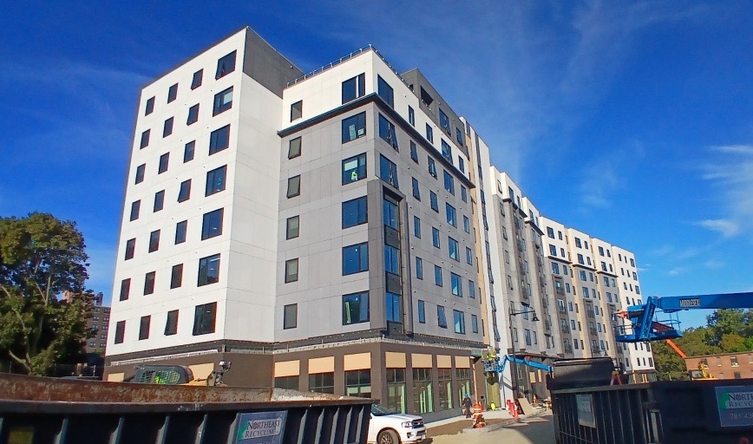
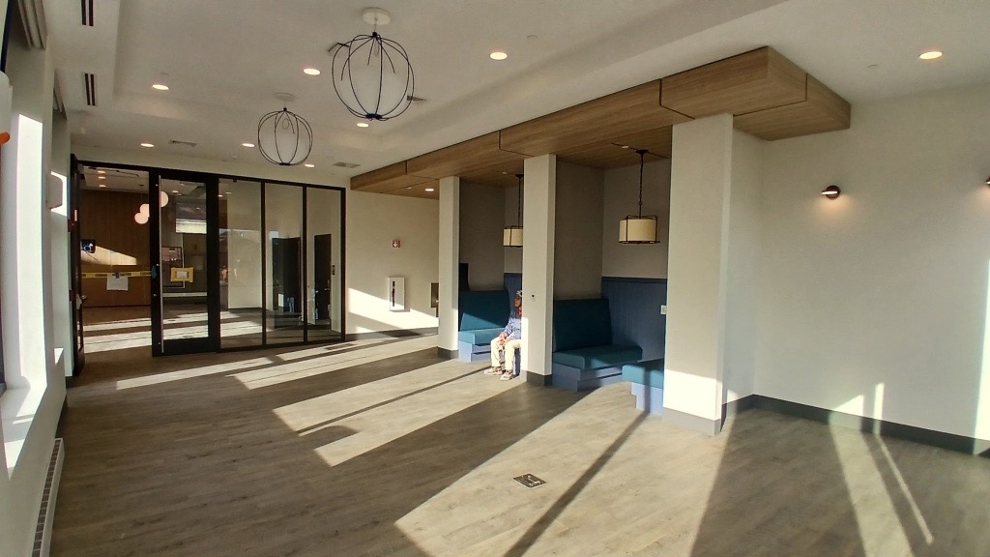
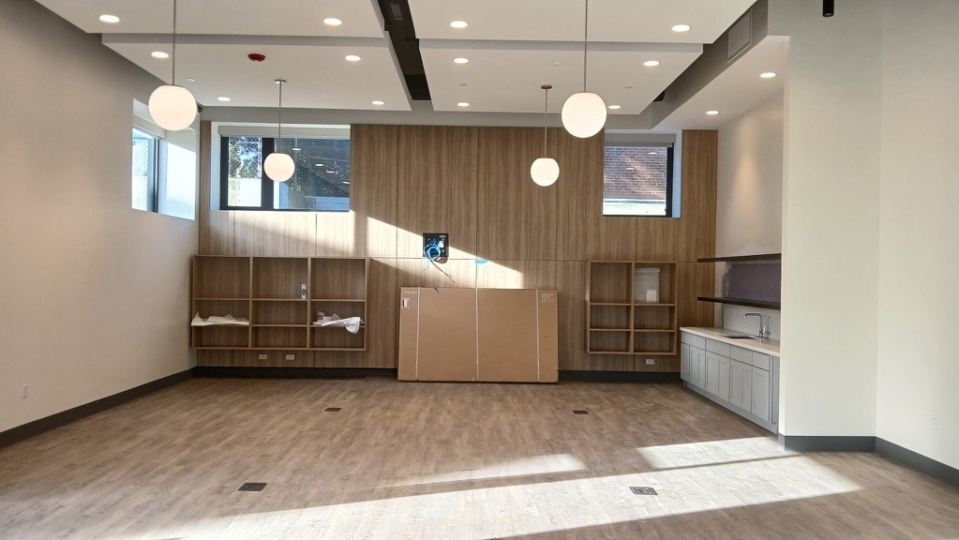
CLARENDON RESIDENT MEETING
November 24, 2025

Slide 3
Introductions
Interpretation Needs (Virtual)
Clarendon Residents United + Legal
Somerville Housing Authority
Housing Opportunities Unlimited
POAH
POAH Communities
SCC

Slide 4
Meeting Agenda
Introductions
Resident Concerns
Phase 2 Updates
SHA Office Hours & Upcoming Events
Q&A

Slide 5
Unit Issues:

Slide 6
Maintenance & Operations:

Slide 7
Relocation:

Slide 8
Accessibility:

Slide 9
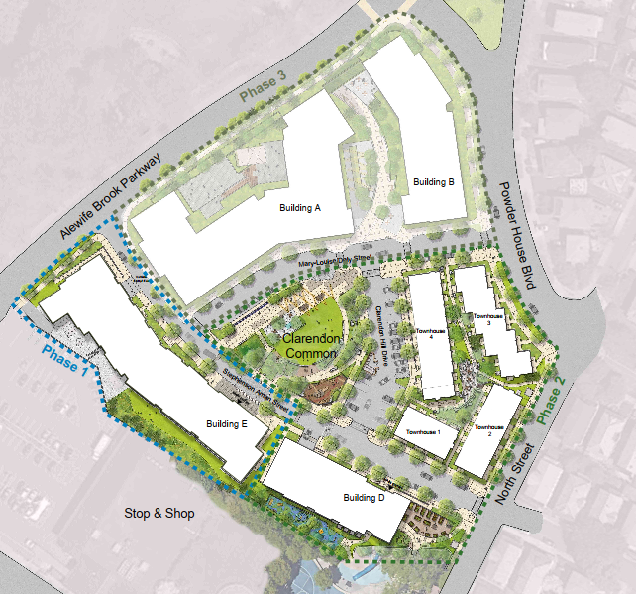


Phase 2 Updates
Phase 2 funding has been received!
Construction will begin in mid-2026 after Building E is complete and fully leased & new financing is in place
Construction anticipated to be completed in 2028, with building fully leased up in 2029
Phase 2 includes Building D (58 units) and Townhomes (34 units), along with a Head Start classroom and playground, community garden, and park space
Note: This is likely the final growing season for the current Clarendon Hill garden. The development team is working with SHA to identify a possible interim garden option during Phase 2 construction.

Slide 10
SHA Office Hours
Tuesday: 8AM – 4PM
Thursday 8AM – 7PM
If you need to meet outside of these hours, you can schedule an appointment by calling 617-666-0425 or 617-625-1152, ext. 805, or by emailing wilmerc@sha-web.org.
You can also contact maintenance directly for any maintenance emergencies or to submit work order requests at 617-625-4425.

Slide 11

Upcoming Events
Resident Celebration: Saturday, December 20th Onsite
HOU IS ON SITE: Monday-Friday 8am-4pm
POAHC IS ON SITE AT 278 POWDER HOUSE BLVD, #14B:
  Monday-Thursday 8am-4:30pm
  Friday 8a-2:30p
CRU Office Space: 139 Alewife Brook Pkwy #17C

Slide 12
Do you have questions? Please contact:
Clarendon Residents Union (CRU): ClarendonResidentsUnion@gmail.com
Developers:
  Jamie Carroll: jcarroll@poah.org
  Beatriz Gomez-Mouakad: bgomez@somervillecdc.org
Relocation Specialist:
  Kamika Marsh: kmarsh@housingopportunities.com; 617-344-9616
Management Team (POAH Communities):
  Tomson Wang: jwang@poahcommunities.com; 617-939-1977
Community Building, Engagement, and Organizing (SCC):
  Bonnie Bastien: bbastien@somervillecdc.org

